Slide 1

Load data into Db2

Slide 2
Objectives
How to use a DB2 service
How to upload documents to a DB2 service.
Load data into Db2

Slide 3
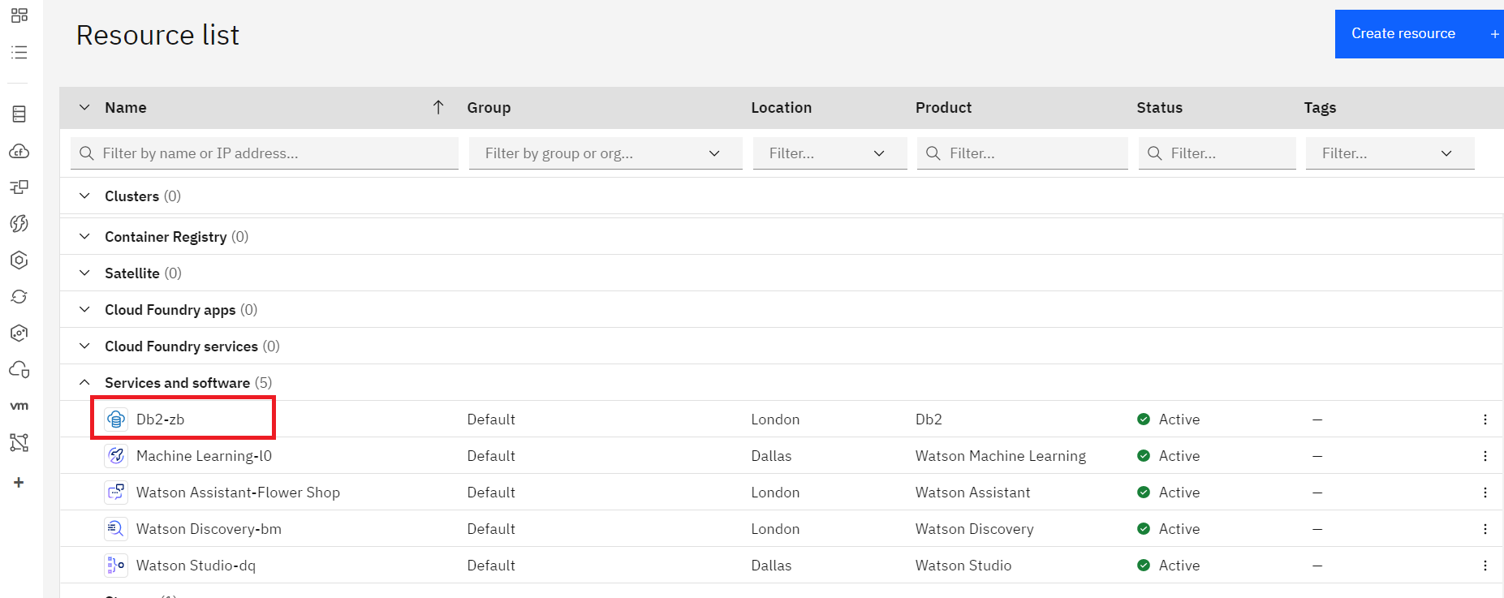
Load data into Db2
From your Dashboard, Click on the Db2 service you created in Lab
Load data into Db2

Slide 4
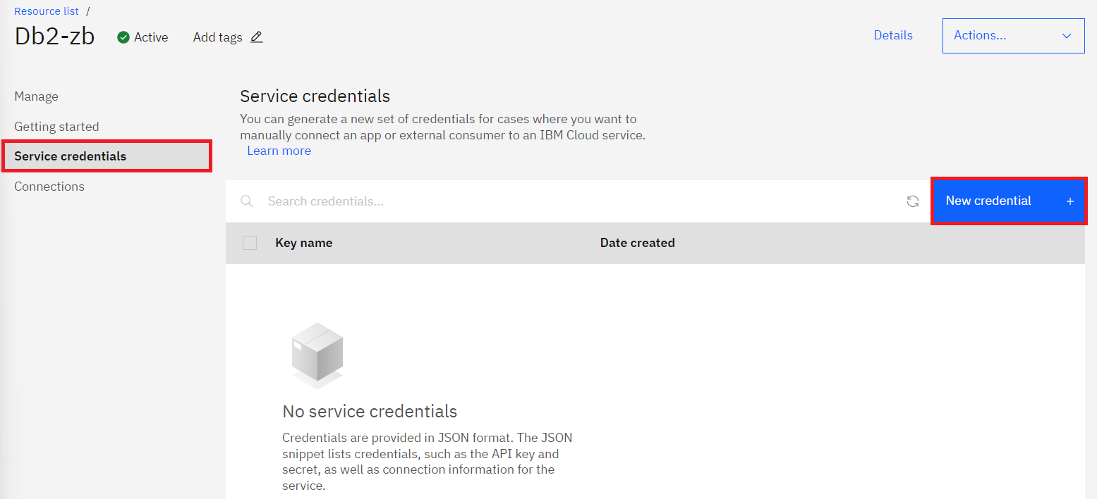
Load data into Db2
A new page will appear. Click on Service credentials to add service credentials for your service.
Click on New credential, Click on Add.
Load data into Db2

Slide 5
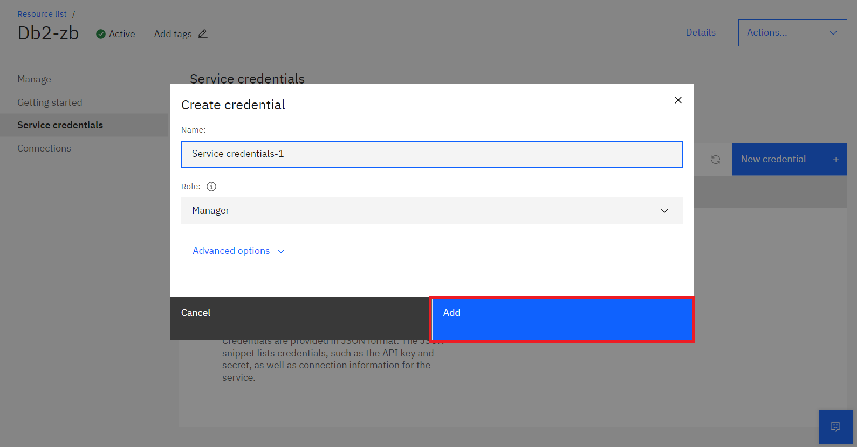
Load data into Db2
Load data into Db2

Slide 6
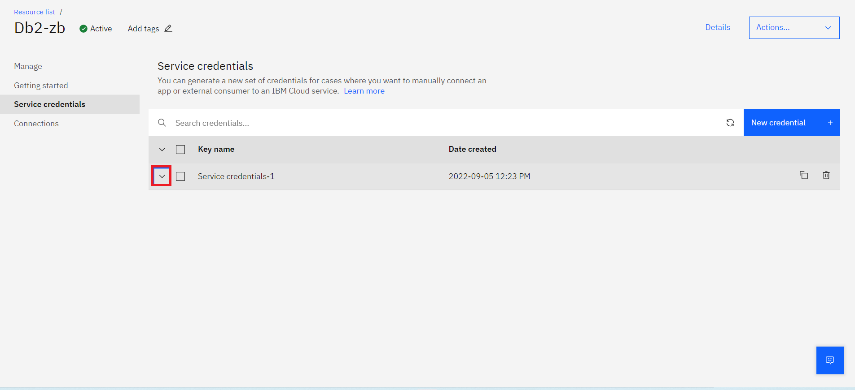
Load data into Db2
Expand the service credential by Clicking on Downward Arrow.
Load data into Db2

Slide 7
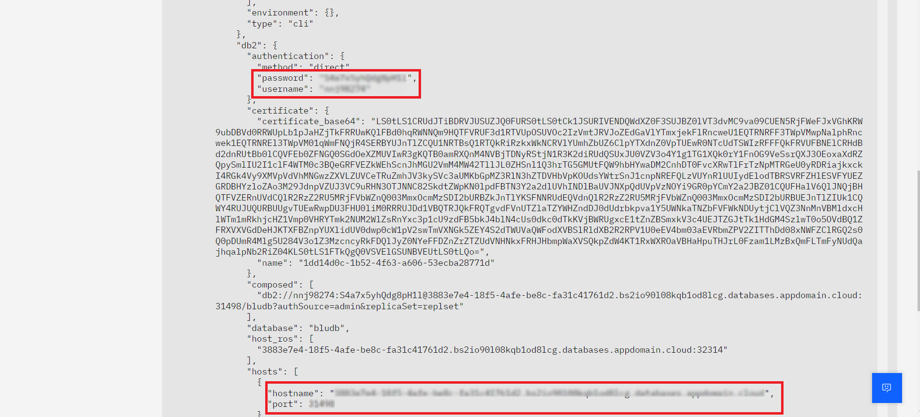
Load data into Db2
Ensure that you make a note of Username, Password, Hostname and Port as these will be used later in the lab.
Load data into Db2

Slide 8
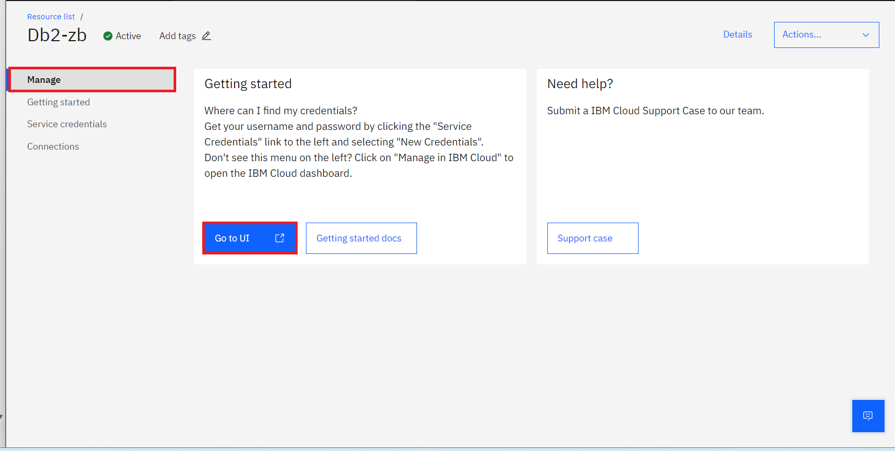
Load data into Db2
Go to Manage Click on the Go to UI.
Load data into Db2

Slide 9
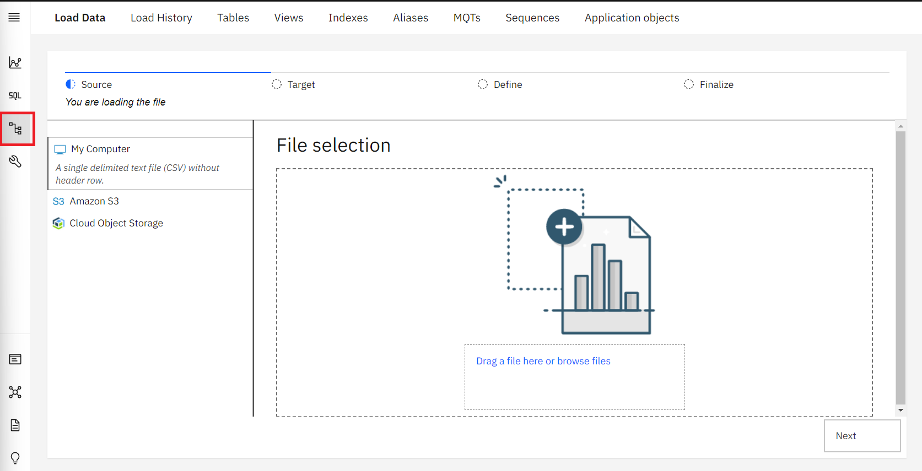
Load data into Db2
A new page will appear. Click on Data icon on left to upload the documents.
Load data into Db2

Slide 10
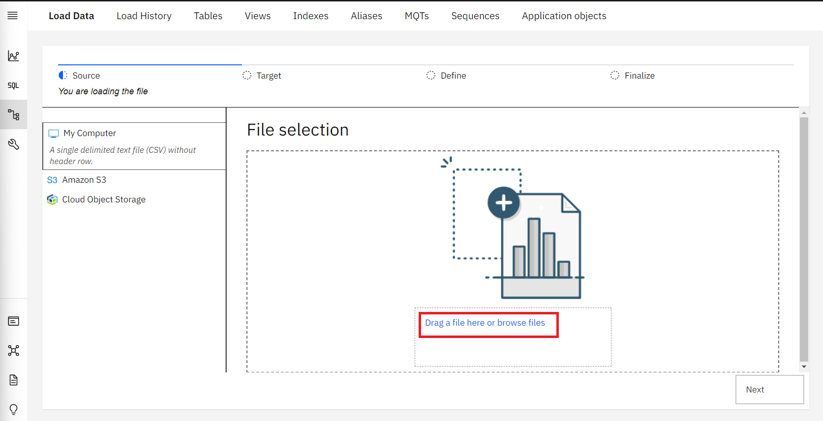
Load data into Db2
You'll see Drag a file here or browse files to upload a document. Click on it and add the file dataset_chapter3.csv. Also you can choose to simply drag and drop the files on the page. And Click on Next.
Load data into Db2

Slide 11
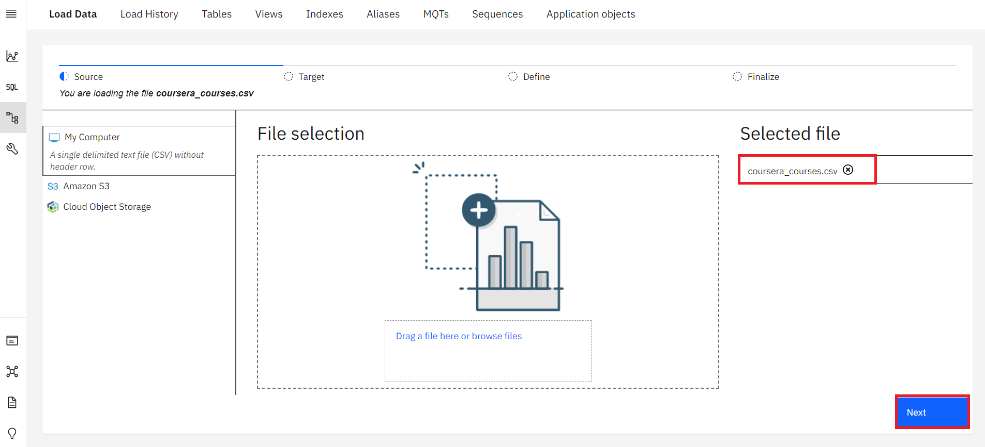
Load data into Db2
Load data into Db2

Slide 12
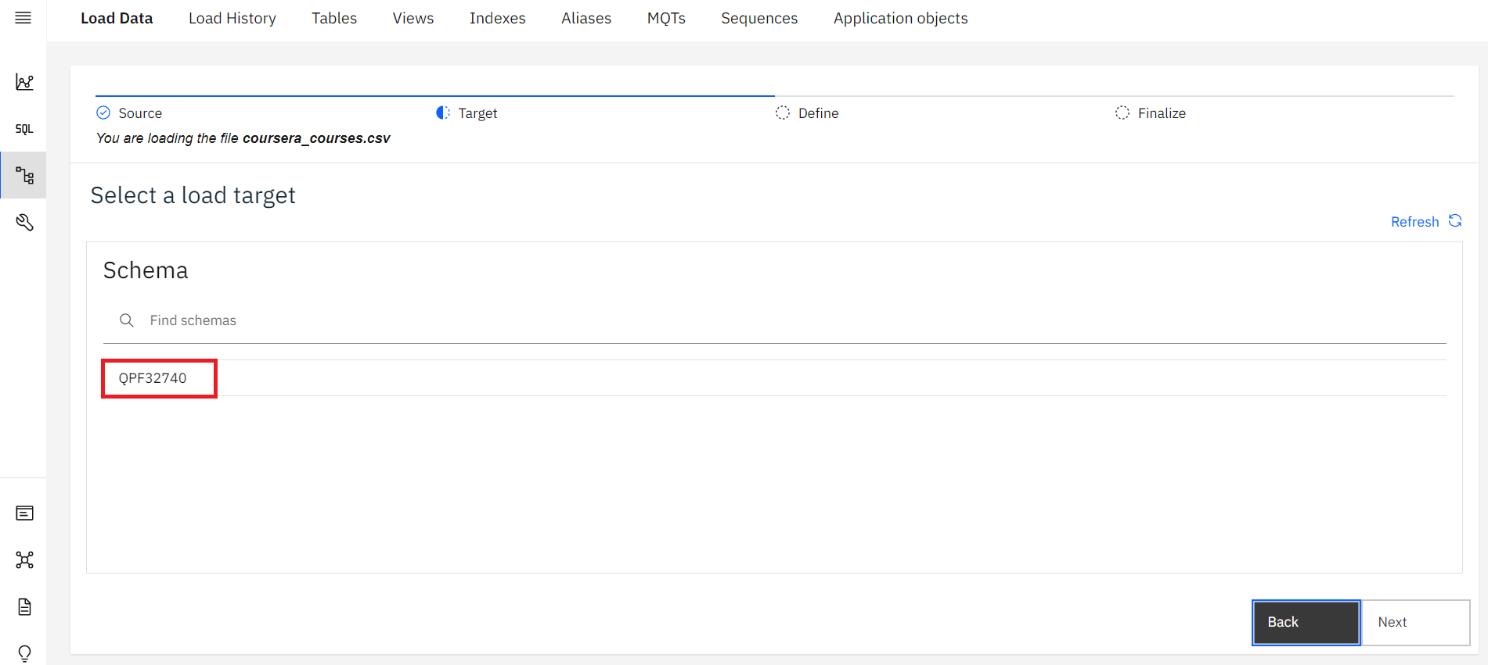
Load data into Db2
Once the import is completed, you should see something similar to the image below. Click on schema given then click on New Table.
Load data into Db2

Slide 13
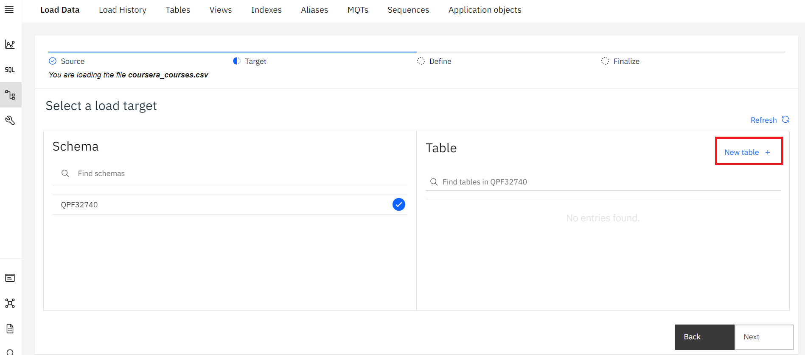
Load data into Db2
Load data into Db2

Slide 14
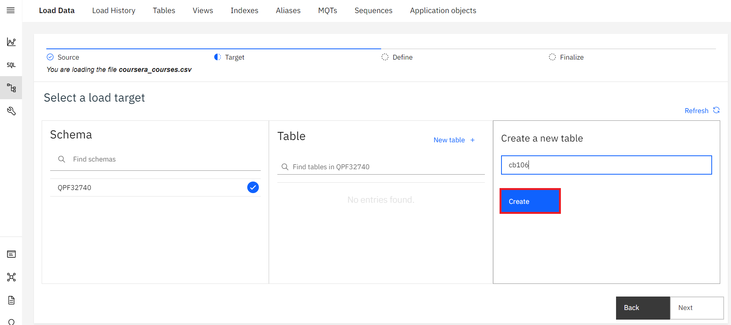
Load data into Db2
Give a name to your table cb106 and click on Create and then click on Next to continue.
Load data into Db2

Slide 15
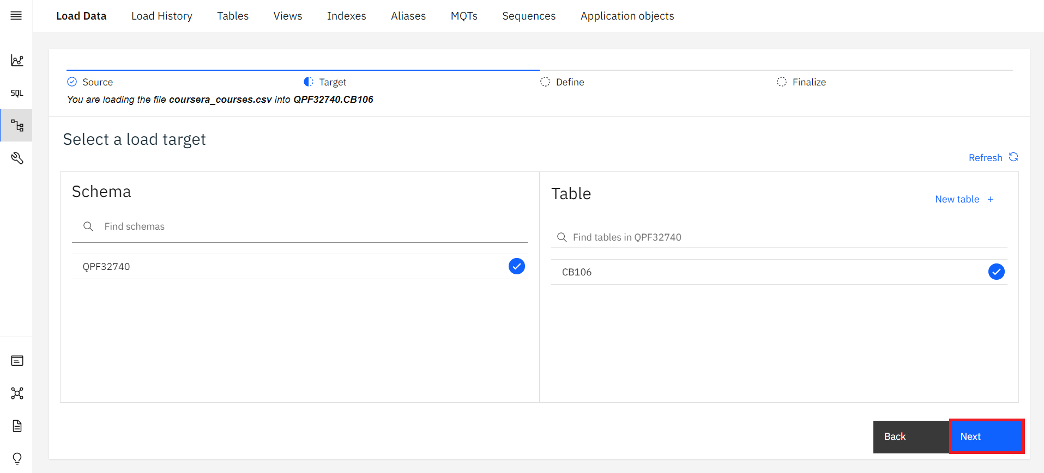
Load data into Db2
Load data into Db2

Slide 16
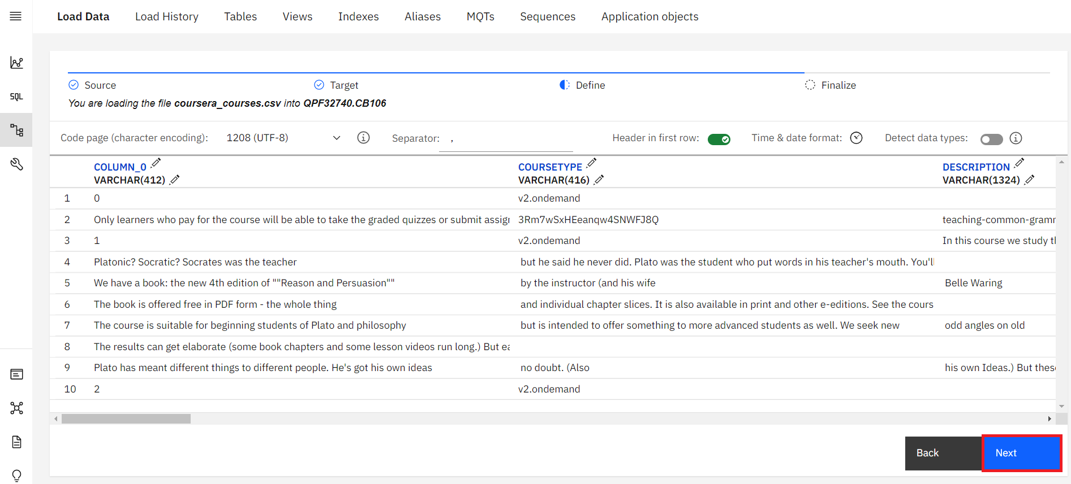
Load data into Db2
You'll see columns are specified in your Table. Click on Next to begin loading your data.
Load data into Db2

Slide 17
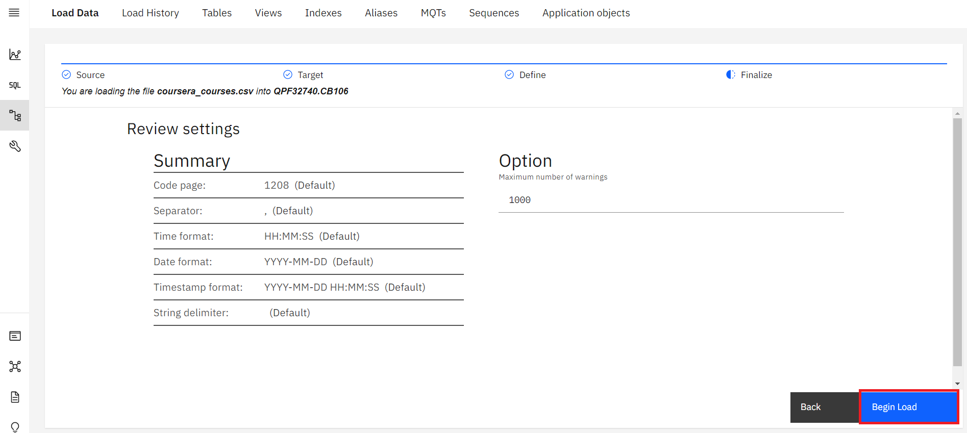
Load data into Db2
Click on Begin Load to start loading your files.
Load data into Db2

Slide 18
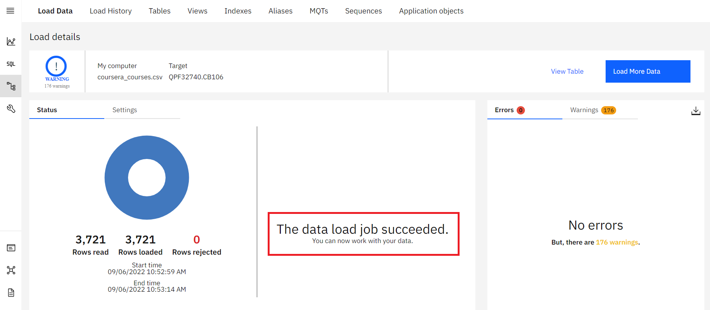
Load data into Db2
Wait until you see something similar to the image below.
Load data into Db2

Slide 19
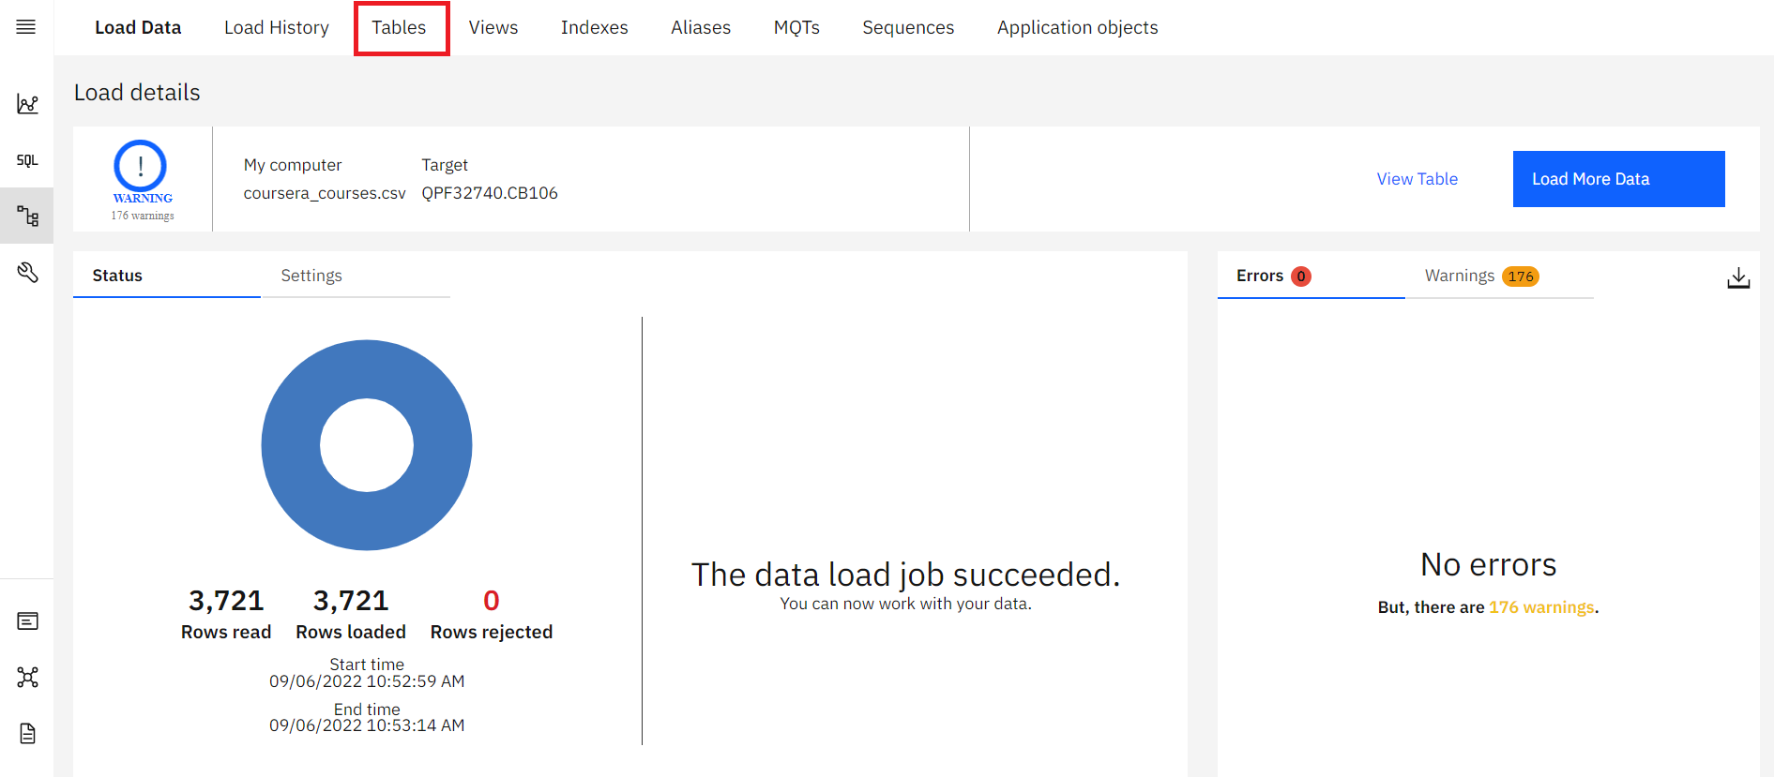
Load data into Db2
Once the load job is done.Click on Tables to view the document you just uploaded.
Load data into Db2

Slide 20
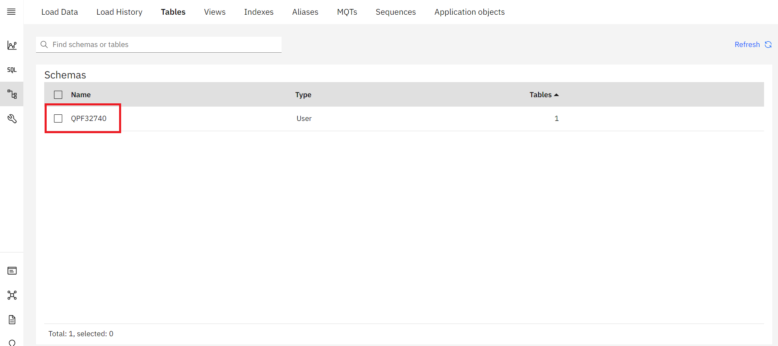
Load data into Db2
Click on Schema as given to view the table and click on the table name cb106.
Load data into Db2

Slide 21
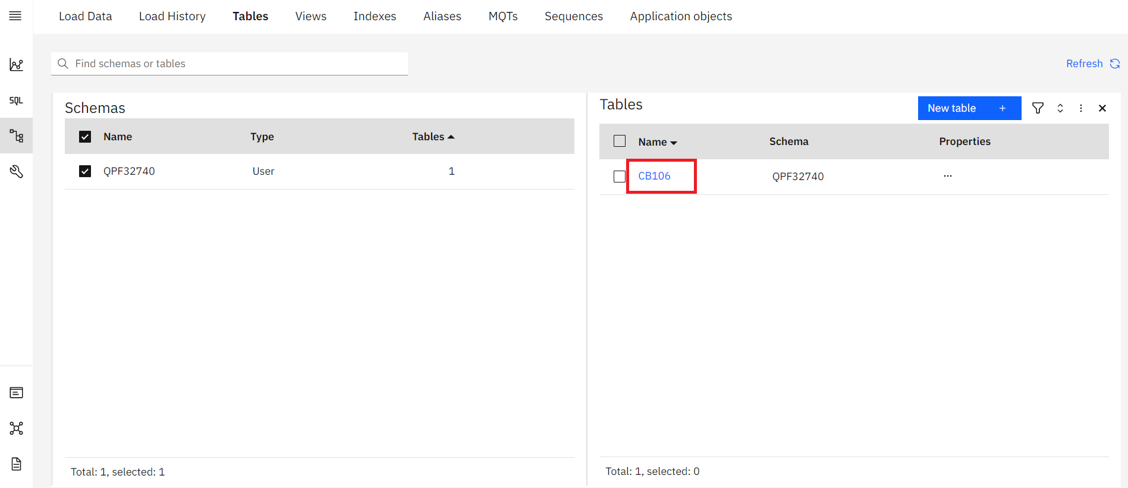
Load data into Db2
Load data into Db2

Slide 22
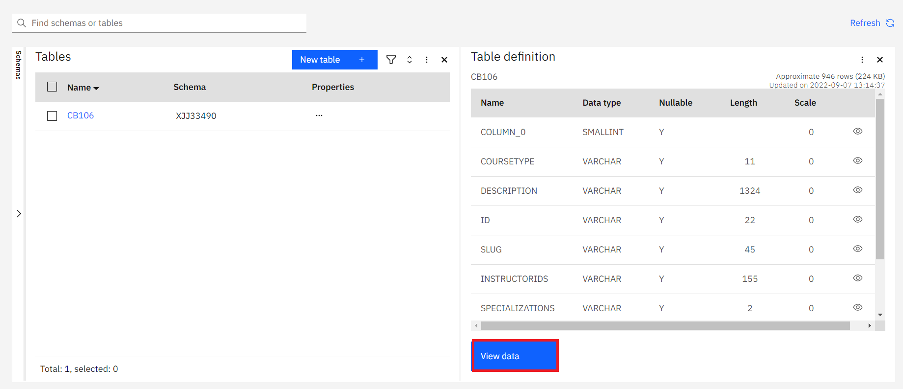
Load data into Db2
Click on View Data to view the content of the table.
Load data into Db2

Slide 23
Summary
How to use a DB2 service
How to upload documents to a DB2 service.
Load data into Db2

Slide 24
Q & A
Load data into Db2

